Slide 1
Cells: Harmonizing Representation
Across Foundry Ontologies
1. Proposed Changes to High Level CL Organization
Extensions for ReO/OBI

Slide 2
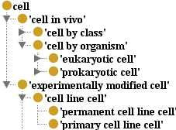
Updating CL Top Level Structure
Previous Structure
Issues to Address:
Consideration of unicellular organism cell types (no such thing as a prokaryotic cell in vivo)
Lack of principled classification of ‘cell’ into disjoint classes that exhaustively partition the domain (‘cell in vivo’ vs ‘exp mod cell)
Minor issues with labels
Lack of definitions for top level classes

Slide 3
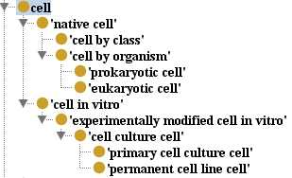
Updating CL Top Level Structure
Previous Structure
Issues to Address:
Consideration of unicellular organism cell types (no such thing as a prokaryotic cell in vivo)
Lack of principled classification of ‘cell’ into disjoint classes that exhaustively partition the domain (‘cell in vivo’ vs ‘exp mod cell)
Minor issues with labels
Lack of definitions for top level classes
Updated Structure
Changes:
Changed label of cell in vivo to ‘native cell’, defined accordingly
Introduced ‘cell in vitro’ class as top level sibling for ‘native cell’
Minor changes to labels
Gave all classes textual definitions

Slide 4
Experimental Relation Between Cell Classes
experimentally modified native cell
experimental modification
experimentally modified cell in vitro
native cell
experimental modification
cell in vitro
(ex vivo or ex env)
collection
(cell labeling)
(cell culturing)
experimental modification
cell culture cell
experimental modification
(cell culture immortalization)
immortal cell line cell

Slide 5
Extending Updated CL in ReO/OBI

Slide 6
Extending Updated CL in ReO/OBI
CL hierarchy remains sparse, but implicit in
it are three dimensions for cell classification:
Context (native vs in vitro)
2. Experimental Status
(experimentally modified vs unmodified)
3. Organism of Origin
(prokaryotic vs eukaryotic?, or multicellular
organism cell vs unicellular organism?)
Many useful classes defined by these axes are not implemented in CL
e.g. no coverage of in vivo experimental cells
e.g. no treatment of multicellular organism cells vs unicellular organisms or breakdown of their related experimental cell types (i.e. cells ex vivo vs ex environment)
In a ReO sandbox, we have followed these three dimensions to their logical conclusion, and in various orders, to flesh out a full hierarchy of cell types, which exhaustively partitions the domain to supply experimentally relevant classes for annotation of biomedical investigations.

Slide 7
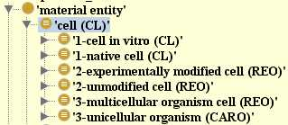
Refine/Define Axes and Apply
Dimensions for Classification
Context
native (in vivo/in environment) vs in vitro (in controlled setting/lab for study)
Experimental Status
experimentally modified vs unmodified* (save this discussion for later)
Organism
unicellular organism vs multicellular organism cell

Slide 8
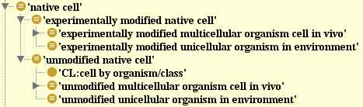
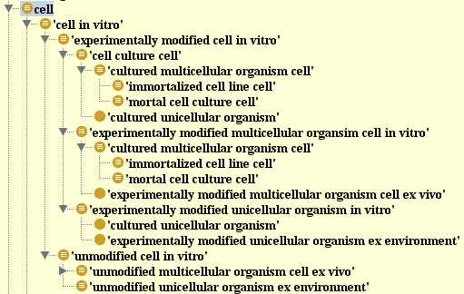
Refine/Define Axes and Apply
Dimensions for Classification
Context
native (in vivo/in environment) vs in vitro (in controlled setting/lab for study)
Experimental Status
experimentally modified vs unmodified* (save this discussion for later)
Organism
unicellular organism vs multicellular organism cell
This order of axes above best reflects what is in CL – but equivalent classes can be created to allow application of axes in any order (e.g to get a class of all experimentally modified cells, all multicellular organism cells, or all cultured cells)

Slide 9
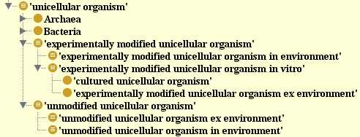
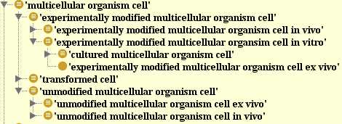
Refine/Define Axes and Apply
Dimensions for Classification : Alternate Order
1. Organism
unicellular organism vs multicellular organism cell
2. Experimental Status
experimentally modified vs unmodified* (save this discussion for later)
3. Context
native (in vivo/in environment) vs in vitro (in controlled setting/lab for study)
This alternate order would reflect a need for a class representing all multicellular organism cells vs all unicellular organisms.
notably, because all classes are logically defined, we get this full hierarchy automatically simply by creating the ‘unicellular organism’ and ‘multicellular organism cell’ defined classes

Slide 10
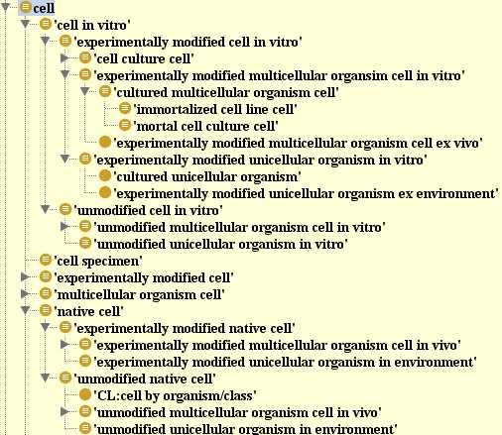
Mapping Between CL and ReO
Updated CL Hierarchy
Expanded ReO Hierarchy
*
* unclear if the CL cell culture cell class here refers only to cultured multicellular organism cells, or all cultured cells

Slide 11
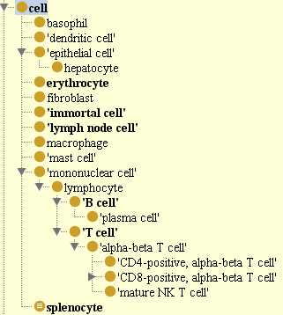
OBI Cell Hierarchy
‘cell’ class imported from CL
a handful of ‘cell in vivo’ subtypes imported form CL
additional in vitro/ experimental cell classes created in OBI (immortal cell, splenocyte, lymph node cell)
all seem to fit within proposed structure
OBI or ReO as potential home for extended modeling of CL classes?
Is the proposed ReO model compatible with what OBI and community needs?

Slide 12
What is ‘experimentally modified’, and why do we care?
Need a precise definition for this concept
note that it is applicable beyond cells
This concept matters to researchers
related to the expectation that a cell (or other entity) will function ‘normally’
this is important for scientists searching for or applying specimens/reagents, and important for interpreting data
What qualifies as an experimental modification?
we use the notion of contextual vs structural/physical processing objectives to answer this question
Role of objectives in classifying a material processing (must consider what is the specified output?) (see following examples of ‘reciprocal processes’)
example : ‘appendix removal’ as contextual vs physical material separation
example: ‘pathogen injection’ as contextual vs physical material combination
Notes:
- This concept that cells have or have not been experimentally matter to researchers
- related to the expectation that cells should function ‘normally’ (of course, removal from their biological context will affect their behavior, being cut off from external cues, but this cannot be helped) looking for and applying materials for their work, and interpreting experimental results.
Examples of reciprocal processes illustrate the notion that it is the objective and identity of the ‘specified’ output that can dictate if a given process represents a contextual or physical processing.
Role of perspective/objectives is key– a given material processing can represent either a contextual or structural processing (or both), depending on the researchers objective (which is indicated by the identity of the specified output)
- ex: a material separation such as appendix removal can be a structural processing it the specified output is a human without appendix, or a contextual processing if the specified output is an appendix that is now ex vivo.
- ex: a material combination such as injecting a pathogen into a lab rat can represent a structural processing if the specified output is the infected rat (ie goal is to study the rat’s response to pathogen), or a contextual processing if the specified output is the pathogen in the new context of the rat (ie the goal is to study the pathogen in the in vivo environment of a host)

